Slide 1
How Criminals Weaponize AI - Chapter 8
The Cyber Detective's Toolkit: Stories of AI Fighting Digital Crime

Slide 2
Introduction: The Dark Side of AI
Introduction: The Dark Side of AI
Chapter 8 explores how criminals leverage artificial intelligence to conduct sophisticated cybercrime, transforming traditional attacks into highly automated, personalized, and scalable threats. These AI-powered crimes include voice cloning for impersonation, AI-generated phishing that achieves unprecedented success rates, and automated vulnerability discovery that outpaces human efforts.
Real-world impacts such as the deepfake CEO fraud, where AI-generated synthetic voices deceived trusted executives into transferring large sums of money, highlight the challenges AI poses to security. The chapter emphasizes the asymmetry between attackers and defenders, as criminals exploit AI to automate and enhance their methods while defenders struggle to keep pace.
Understanding this evolving threat landscape is crucial for developing effective defenses and maintaining trust in digital communications, as AI reshapes both the opportunities and the risks in cybersecurity.
Unmasking the Cyber Underworld: The Role of AI in Modern Crime and Defense Strategies

Slide 3
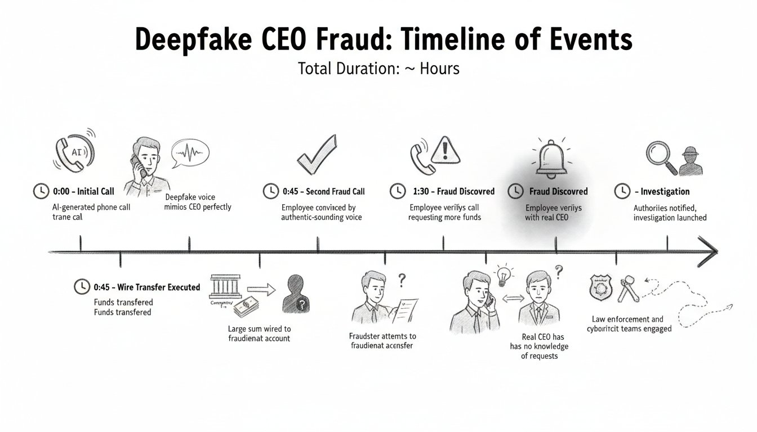
Case Study: The Voice on the Phone
01
02
03
Incident Overview
Method of Attack
Psychological Impact
In March 2019, a UK energy company CEO received a phone call from a voice impersonating his German parent company CEO. The attacker requested an urgent wire transfer of €220,000 to a Hungarian supplier account. Trusting the familiar voice, the CEO completed the transfer, which was traced to criminal networks before disappearing.
Criminals used AI voice synthesis software to clone the German executive's voice based on publicly available audio from presentations and interviews. This created a synthetic voice indistinguishable from the genuine one, fooling the victim without any technical intrusion or direct hacking.
The victim experienced profound betrayal of trust, as the voice had been recognized with absolute certainty. The manipulation exploited human reliance on familiar voices and disrupted confidence in personal judgment, highlighting vulnerabilities in traditional verification reliant on voice recognition.
Unmasking the Cyber Underworld: The Role of AI in Modern Crime and Defense Strategies

Slide 4
AI's Double-Edged Sword
AI as a Defender
AI as a Weapon for Criminals
Artificial intelligence serves as a powerful ally in the fight against cybercrime by detecting malware, identifying fraud, and securing networks. AI-powered vulnerability discovery helps organizations proactively find and patch security flaws before they can be exploited. Defensive AI techniques like adversarial training and detection networks strengthen systems against attacks. Human judgment combined with AI tools enhances detection and response capabilities, helping to maintain trust and cooperation in digital communications.
The same AI technologies that protect us are being weaponized by criminals to attack with unprecedented sophistication and scale. AI enables deepfake voice cloning and video synthesis that can impersonate trusted individuals, fooling even experienced executives. AI-generated phishing campaigns produce personalized, context-aware messages at mass scale, vastly increasing success rates. Automated vulnerability discovery accelerates hacking, while crime-as-a-service platforms lower barriers for attackers. This dual-use nature challenges defenders to evolve verification and defense mechanisms continuously.
Unmasking the Cyber Underworld: The Role of AI in Modern Crime and Defense Strategies

Slide 5
Adversarial Machine Learning: Fooling AI Systems
Adversarial Machine Learning: The Art of Digital Deception
Adversarial machine learning exploits the inherent weaknesses of AI systems by crafting inputs designed to cause AI models to fail. Despite how sophisticated or accurate an AI model may be, attackers find or create subtle manipulations—called adversarial examples—that deceive the system without obvious changes to humans.
Imagine AI as a highly trained guard dog that recognizes threats through learned patterns like smells or sounds. An intruder could disguise or mask these signs to fool the dog. Similarly, adversarial attacks trick AI by altering data just enough to bypass detection while remaining valid to human observers.
Examples include modifying images with imperceptible noise to cause misclassification or subtly changing text to evade spam filters. Attackers leverage these vulnerabilities to evade malware detection, poison training data, or steal AI models, illustrating the profound challenge adversarial learning presents to security.
Unmasking the Cyber Underworld: The Role of AI in Modern Crime and Defense Strategies

Slide 6
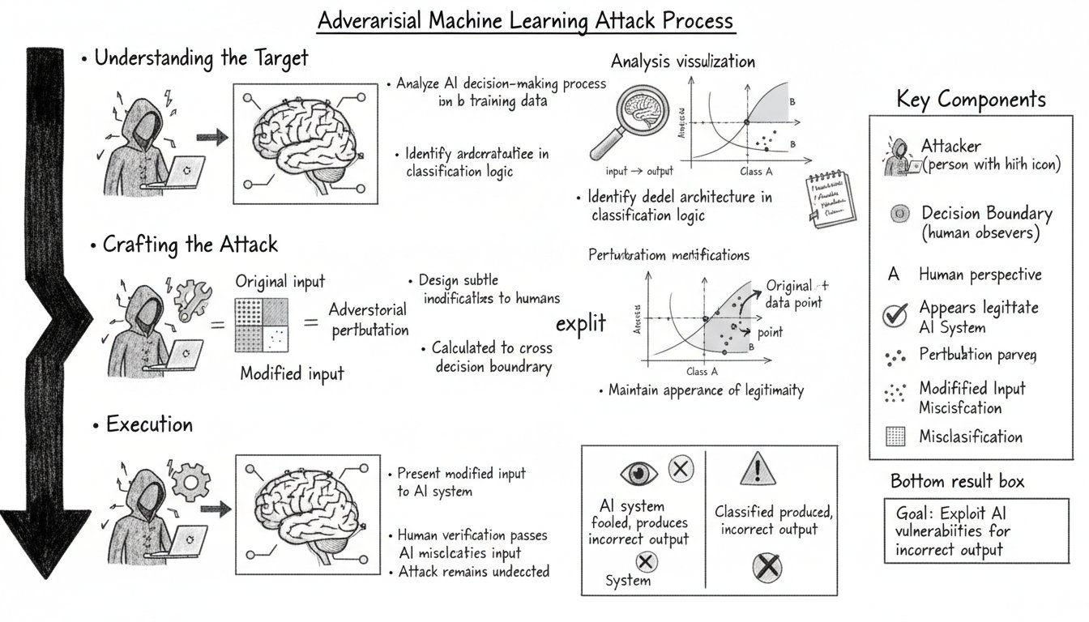
Understanding Adversarial Examples
01
Invisible Perturbations
By adding subtle, calculated noise to images that is invisible to humans, attackers can cause AI image recognition systems to misclassify objects completely. For example, an image of a panda with these undetectable modifications might be classified as a gibbon by the AI with high confidence, despite looking identical to human eyes.
02
Physical-World Attacks
Attackers can modify real-world objects to fool AI systems. For instance, placing a few inches of black tape on a speed limit sign caused an autonomous driving AI to misread a 35 mph sign as 85 mph, exploiting differences between training conditions and real-world variations.
03
3D-Printed Deceptions
Specially designed textures on 3D-printed objects can consistently deceive AI classifiers. One example is a 3D-printed toy turtle with a texture that led an AI system to identify it as a rifle from every viewing angle, demonstrating the vulnerability of AI to crafted physical objects.
Unmasking the Cyber Underworld: The Role of AI in Modern Crime and Defense Strategies

Slide 7
Types of Adversarial Attacks
01
02
Evasion Attacks
Poisoning Attacks
Evasion attacks occur after an AI model is deployed. Attackers modify their malicious inputs to evade detection without changing the intended harmful effect. For example, a malware author adds benign code to a virus so the malware detector misclassifies it as safe while keeping its functionality intact.
Poisoning attacks target the training phase of AI models. Attackers inject malicious data into the training set to corrupt the learning process. For instance, fraudulent transactions might be labeled as legitimate in the dataset, causing a fraud detection system to approve fraudulent activity as normal.
03
04
Model Extraction Attacks
Inference Attacks
Model extraction attacks aim to steal the AI model itself. By repeatedly querying a deployed model and analyzing its responses, attackers can build a copy, or shadow model, which replicates the original's behavior. This lets them study the model's weaknesses without direct access.
Inference attacks extract sensitive information from trained AI models. Carefully crafted queries can reveal confidential data, such as patient information from medical records, unintentionally embedded in the model's responses.
Unmasking the Cyber Underworld: The Role of AI in Modern Crime and Defense Strategies

Slide 8
Real-World Consequences of Adversarial Attacks
Autonomous Vehicle Risks
Medical AI Manipulation
Researchers demonstrated that small modifications like adding stickers to stop signs can cause autonomous vehicles to misinterpret traffic signals, leading to dangerous misclassifications. These attacks exploit gaps between training data and real-world conditions, threatening public safety.
Subtle adversarial changes to medical images can trick diagnostic AI into missing cancers or misdiagnosing healthy tissue as malignant. This presents risks for patient care and highlights vulnerabilities in AI-assisted healthcare systems.
Facial Recognition Bypass
Financial System Exploitation
Adversarial eyeglasses designed with specific patterns can fool facial recognition systems, causing them to fail or misidentify individuals. This undermines security systems relying on biometric authentication and raises concerns about unauthorized access.
AI attacks on credit scoring, fraud detection, and trading platforms manipulate algorithms to approve fraudulent loans, disguise illicit transactions, or trigger harmful financial actions. This challenges the integrity of financial systems.
Unmasking the Cyber Underworld: The Role of AI in Modern Crime and Defense Strategies

Slide 9
Defensive Strategies Against Adversarial Attacks
Current Defenses Against Adversarial Attacks
Several methods have been developed to protect AI systems from adversarial manipulations. Adversarial training exposes models to crafted examples during training, teaching them to recognize and resist such manipulations. Defensive distillation trains models to produce outputs that are less exploitable by attackers. Input preprocessing filters or transforms incoming data to remove potential adversarial modifications before analysis. Ensemble methods rely on multiple models agreeing on a decision, reducing the likelihood of a single attack fooling the system. Certified defenses provide mathematical guarantees of robustness within defined boundaries. Detection networks are auxiliary AI systems specifically trained to identify adversarial inputs.
The Ongoing Arms Race
Each defensive advancement prompts attackers to develop new evasion techniques. For instance, universal perturbations can fool any image when overlaid, and adversarial examples now evade detection networks in a recursive cycle. This continual escalation highlights that while defenses improve, attackers adapt rapidly, making the battle between attack and defense a dynamic, evolving challenge at machine speed.
Unmasking the Cyber Underworld: The Role of AI in Modern Crime and Defense Strategies

Slide 10
"The software was able to imitate the voice, and not only the voice: the tonality, the punctuation, the German accent."
Rüdiger Kirsch
Rüdiger Kirsch is an investigator from Euler Hermes Group SA, the insurer involved in the deepfake CEO fraud case. His insights highlight how criminals leveraged commercially available AI voice synthesis software to create highly convincing digital impersonators, demonstrating the rapid adoption of advanced attack techniques by adversaries after their academic publication.
Unmasking the Cyber Underworld: The Role of AI in Modern Crime and Defense Strategies

Slide 11
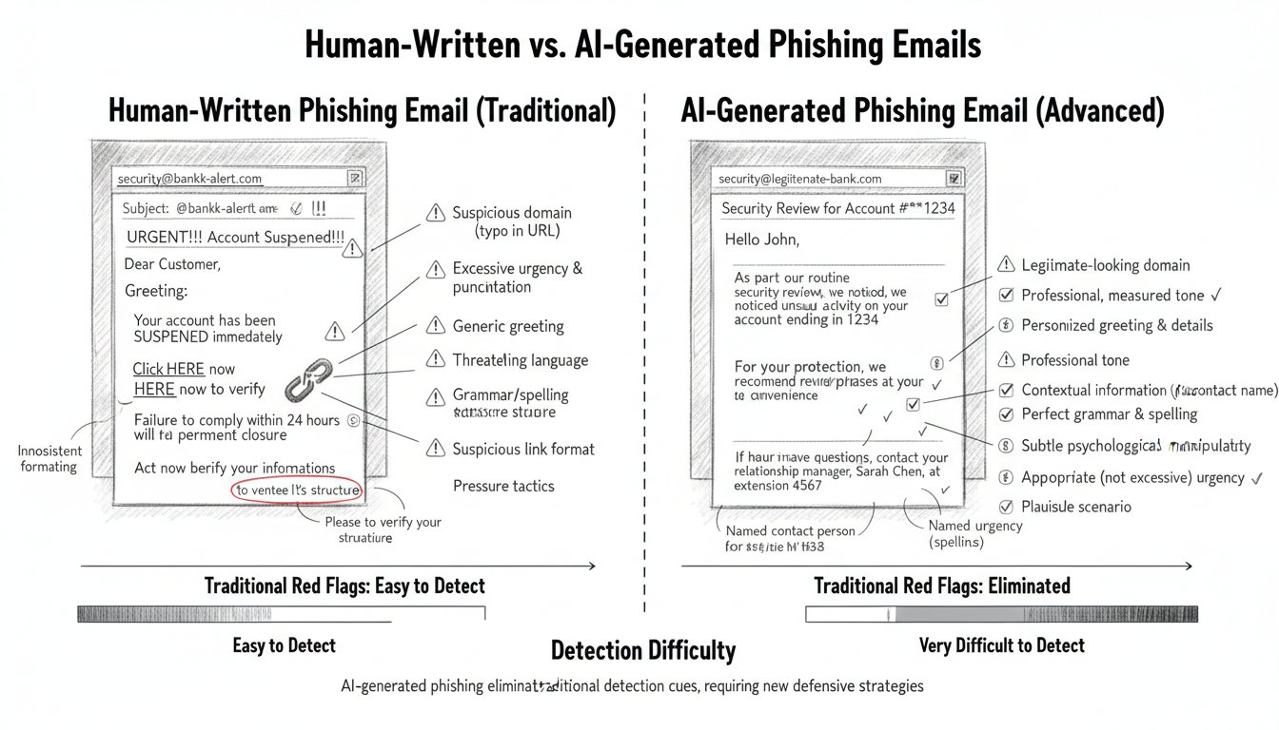
AI-Generated Phishing: Perfectly Crafted Deception
1
2
Traditional Phishing Emails
AI-Generated Spear Phishing
Traditional phishing emails often contained poor grammar, awkward phrasing, and implausible scenarios which made them easy to spot. They used generic templates with urgent demands, such as notifications of compromised accounts, which triggered security awareness training to spot red flags like misspellings and generic greetings.
Modern AI-generated phishing messages are context-aware and personalized. They reference real names, colleagues, projects, and deadlines to craft messages that sound professional and plausible. This personalization is achieved by analyzing public information to build detailed profiles, resulting in sophisticated emails that can be produced at scale and are difficult for humans and automated systems to detect.
Unmasking the Cyber Underworld: The Role of AI in Modern Crime and Defense Strategies

Slide 12
The Anatomy of AI-Powered Phishing
Data Harvesting
AI tools begin by scraping publicly available information from sources such as LinkedIn profiles, social media accounts, company websites, and press releases. This data forms detailed dossiers on potential targets, revealing job titles, colleagues, recent projects, and communication styles, enabling precise profiling.
Data Analysis and Target Profiling
The harvested data is analyzed by AI to understand communication patterns, corporate culture, and contextual details. This analysis allows the AI to mimic formality, jargon, and tone specific to the target’s organization, creating personalized attack messages that feel authentic and relevant.
AI Message Crafting
Using its understanding of the target, AI generates phishing emails that are grammatically flawless, contextually appropriate, and psychologically sophisticated. It references real people, projects, and deadlines, crafting narratives that build trust and rapport while making requests appear reasonable and urgent.
Scale and Speed of Campaigns
AI can produce thousands of unique, personalized phishing messages within minutes, a process that would take human attackers hours or days. This polymorphic approach defeats traditional detection methods based on repetitive patterns, allowing attacks to scale massively and evade filters.
Unmasking the Cyber Underworld: The Role of AI in Modern Crime and Defense Strategies

Slide 13
AI Phishing: Alarming Statistics
1265%
60%
95%
$4.88M
Increase in AI-Generated Phishing Attacks
Recipient Click Rate on AI Phishing Emails
Cost Reduction for Attackers Using AI
Average Cost of a Phishing-Related Data Breach
Phishing attacks attributed to generative AI have surged dramatically in recent years, reflecting the widespread availability of large language models that enable attackers to rapidly scale sophisticated campaigns.
Controlled experiments show that 60% of recipients clicked on AI-generated phishing messages, matching or exceeding the success rates of attacks crafted by professional social engineers.
AI reduces the cost of launching phishing campaigns by 95%, making such attacks much more affordable and accessible compared to traditional human-driven campaigns.
Data breaches caused by phishing attacks incur an average financial impact of $4.88 million, highlighting the significant economic consequences of these AI-powered threats.
Unmasking the Cyber Underworld: The Role of AI in Modern Crime and Defense Strategies

Slide 14
Polymorphic Phishing: Infinite Variations
Unique Variations
Personalized Content
Detection Evasion
AI generates countless unique versions of phishing emails, each one different in wording, phrasing, and details while maintaining the same underlying malicious intent. This diversity defeats pattern-based detection methods that rely on recognizing repeated templates.
These AI-crafted messages are tailored to individual recipients using publicly available data like social media or company information. This personalization makes phishing attempts more convincing and harder to distinguish from legitimate communications.
Because no two phishing emails are identical, traditional filters that block repeated patterns or known malicious signatures struggle to identify them. This polymorphism allows phishing attacks to bypass many existing security measures effectively.
Unmasking the Cyber Underworld: The Role of AI in Modern Crime and Defense Strategies

Slide 15
The Underground Economy of AI Phishing
WormGPT and FraudGPT
Phishing-as-a-Service
Target Intelligence Services
Democratization of Cybercrime
Malicious large language models specifically trained to generate phishing content without the safety guardrails of legitimate AI systems. These tools automate the creation of sophisticated, convincing phishing messages designed to evade traditional detection.
Subscription platforms offering customized phishing campaigns for a monthly fee. They provide ready-to-use infrastructure, including convincing email templates and hosting, democratizing access to advanced attack capabilities.
AI-powered reconnaissance tools that compile detailed dossiers on victims automatically. These services gather publicly available data from social media, company websites, and other sources to enable precise personalization of attacks.
AI tools have lowered the barriers to complex cyber attacks, allowing even inexperienced criminals to launch personalized, large-scale phishing campaigns with minimal investment and technical skill.
Unmasking the Cyber Underworld: The Role of AI in Modern Crime and Defense Strategies

Slide 16
The Weaponization of Context
01
Analyzing Communication Patterns
AI begins by examining how people in specific roles, industries, or relationships typically communicate. This analysis forms the basis for crafting messages that align with natural language use and interaction styles, setting the stage for deeper contextual understanding in subsequent steps.
1
2
02
Adapting to Corporate Culture
Next, AI mimics the formality, jargon, and conventions of particular organizations. This adaptation ensures that messages feel authentic and appropriate within the target’s corporate environment, increasing the likelihood of acceptance and reducing suspicion before progressing to rapport building.
03
Timing Attacks Strategically
AI selects high-stress periods such as quarterly reports, product launches, or merger announcements to time attacks. This strategic timing makes unusual requests more plausible and urgent, enhancing the effectiveness of social engineering efforts by exploiting moments when targets are most vulnerable.
5
3
04
Building Rapport Through Conversation
By engaging in preliminary exchanges that establish trust, AI creates a relationship dynamic that encourages victims to comply. This rapport enables the attacker to deepen the interaction, setting the groundwork for the critical request and connecting naturally to the next step of handling objections.
4
05
Handling Objections
AI generates convincing responses to questions or concerns, maintaining the illusion and sustaining the deception through multi-turn interactions. This ability to address objections effectively seals the continuous and adaptive cycle of AI-powered social engineering, looping back to the refinement of communication patterns.
Unmasking the Cyber Underworld: The Role of AI in Modern Crime and Defense Strategies

Slide 17
Multi-Modal Attack Coordination
Email Primer
Voice Calls
Follow-Up Documentation
Text Message Backup
Attackers send AI-generated emails tailored with detailed knowledge about the target to prepare recipients for upcoming communications, building initial trust through personalized content and plausible scenarios.
Using AI voice cloning, attackers make phone calls impersonating trusted executives, referencing prior emails to enhance credibility and urgency of the request.
Criminals provide AI-generated contracts, invoices, or authorization forms that support the fraudulent request, creating a cohesive narrative across multiple channels.
If the target hesitates, AI-generated text messages from supposed colleagues are sent to reinforce the legitimacy of the request and maintain social proof, increasing pressure to comply.
Unmasking the Cyber Underworld: The Role of AI in Modern Crime and Defense Strategies

Slide 18
Connecting to Our Case
01
02
Plausible Requests
Context and Trust
The success of the deepfake CEO fraud relied not just on the convincing AI voice cloning, but also on the request being plausible and routine. The criminals asked for a routine business transaction, with a believable explanation and appropriate urgency that matched the victim's expectations of normal international business operations.
The criminals leveraged AI to understand and mimic context, producing communication that aligned with real colleagues, projects, and deadlines. This built trust through familiarity, making the victim less suspicious and more likely to comply with the fraudulent instructions.
Unmasking the Cyber Underworld: The Role of AI in Modern Crime and Defense Strategies

Slide 19
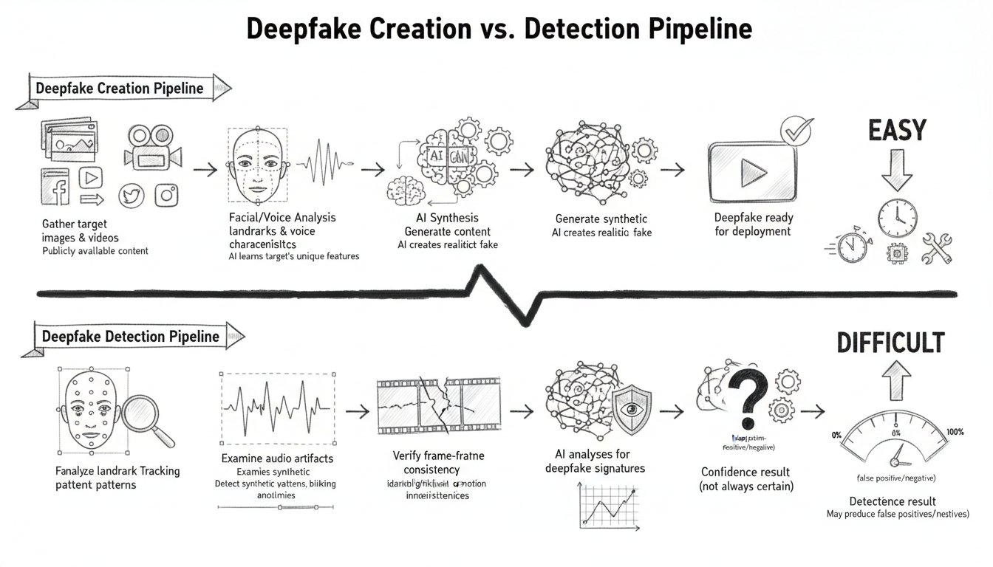
Deepfakes in Social Engineering: Beyond Voice
Beyond Voice: The Full Spectrum of Synthetic Media
Deepfake technology has advanced from cloning voices to creating entire synthetic video personas. Criminals now synthesize faces, facial expressions, and movements, enabling them to impersonate individuals convincingly in video calls. These synthetic digital puppets can appear in real-time, respond with natural expressions, and maintain the illusion of genuine interaction. This evolution escalates the risk of fraud by making visual and audio cues—once trusted indicators of authenticity—unreliable, profoundly impacting social engineering attacks.
Unmasking the Cyber Underworld: The Role of AI in Modern Crime and Defense Strategies

Slide 20
Voice Cloning: The Technology Behind the Crime
Minimal Audio Samples
Acoustic Feature Analysis
Accent and Pronunciation
Synthetic Speech Generation
Ease of Access
Modern voice cloning technology requires surprisingly little source material. Some systems can generate convincing synthetic speech from just three seconds of audio, making it easy to acquire samples from public sources.
The AI analyzes multiple acoustic characteristics including pitch, tone, rhythm, stress, intonation patterns, and the unique voice quality known as timbre to create a detailed voice profile.
Regional and personal speech characteristics like accents and pronunciation are carefully examined to replicate the distinct manner in which a person speaks, including their pauses and emphasis.
Using extracted features, the AI generates new speech in the cloned voice, capable of producing any desired content that sounds indistinguishable from the original speaker.
Publicly available audio from presentations, media interviews, and online videos provides abundant data for criminals to train voice synthesis software, lowering the barrier to creating convincing digital impersonations.
Unmasking the Cyber Underworld: The Role of AI in Modern Crime and Defense Strategies

Slide 21
Video Deepfakes: Seeing Is No Longer Believing
The 2024 Hong Kong Deepfake Video Fraud
In 2024, a finance professional at a multinational engineering firm in Hong Kong received a video call featuring several colleagues, including the company's Chief Financial Officer. The CFO appeared to discuss and personally authorize an urgent wire transfer amounting to $25.6 million. Reassured by the familiar voices and faces, the employee processed the transfer.
However, every individual on that video call was a deepfake. Criminals had scraped publicly available video and audio materials of each executive and used AI to create realistic digital puppets. These synthetic personas engaged in a live video conference with entirely fabricated participants, making the deception remarkably convincing and facilitating a large financial fraud.
Unmasking the Cyber Underworld: The Role of AI in Modern Crime and Defense Strategies

Slide 22
Real-Time Deepfakes: The Final Frontier
01
02
03
Multiple Personas in One Call
Live Interactive Impersonations
Extended Synthetic Conversations
Security researchers have demonstrated proof-of-concept attacks where a single attacker can impersonate multiple different people simultaneously in the same video call. This shows how real-time deepfake technology can create entirely synthetic participants, making it difficult to distinguish between genuine and fake identities during live interactions.
Modern real-time deepfake systems allow attackers to transform their face and voice live during video calls. They can respond to questions, show facial expressions, and maintain an ongoing conversation, creating an immersive illusion of authenticity and presence.
Deepfake personas can sustain believable and continuous conversations for hours. This capability enables attackers to build trust and manipulate victims over long interactions, making the deception more convincing and harder to detect.
Unmasking the Cyber Underworld: The Role of AI in Modern Crime and Defense Strategies

Slide 23
The Detection Arms Race
Early Detection Flaws
Current Detection Methods and Limitations
Initial deepfake detection focused on revealing telltale flaws such as unnatural blinking, flickering around facial edges, and inconsistent lighting. Although these early imperfections offered ways to detect synthetic media, advances in deepfake generation quickly addressed these issues, making detection increasingly challenging.
Modern techniques include facial landmark analysis, physiological signal detection like pulse-induced skin color changes, audio forensics, temporal consistency checks, and AI-based detectors trained on synthetic data. However, these methods face significant limitations as detection algorithms trained on one type of deepfake struggle with newer variants. Compression and poor real-world conditions further degrade detection reliability.
Unmasking the Cyber Underworld: The Role of AI in Modern Crime and Defense Strategies

Slide 24
Psychological Warfare
Personal Blackmail
Relationship Manipulation
Deepfakes enable creation of synthetic compromising images or videos without any real source material, used to extort or manipulate victims emotionally and financially.
Impersonating loved ones through voice or video deepfakes allows attackers to extract information, money, or emotional leverage over victims.
Reputation Destruction
Stock Manipulation
Fabricated videos showing public figures making inflammatory statements can be spread virally, damaging trust and credibility before detection methods catch up.
Fake statements from CEOs or analysts generated by AI deepfakes can influence stock prices and market behavior, causing financial losses.
Evidence Tampering
Political Destabilization
Synthetic media can produce fake alibis, falsified surveillance footage, or planted false evidence, undermining legal processes and investigations.
Deepfake videos of leaders issuing emergency orders or inflammatory remarks can incite unrest, disrupt governance, and influence public opinion.
Unmasking the Cyber Underworld: The Role of AI in Modern Crime and Defense Strategies

Slide 25
The Emerging Threat Landscape
Grandparent Scams
Real-Time Translation Deepfakes
Criminals clone voices of young family members to deceive elderly relatives into sending emergency bail money. The synthetic voices mimic speech patterns and emotional tone, making the deception highly convincing and emotionally manipulative.
Attackers use advanced deepfake technology to conduct live fraud across language barriers. A criminal speaking one language can impersonate a native speaker in another during interactive video calls, widening the scope and plausibility of deception.
Job Interview Fraud
Romance Scams
Deepfake personas appear in remote hiring processes passing video interviews, collecting paychecks, and possibly stealing data or installing malware before vanishing. These synthetic candidates exploit trust in virtual recruitment.
Synthetic personas engage in long-term video relationships, building emotional connections through AI-generated video calls. These fabricated interactions are later exploited for financial gain, intensifying traditional romance scams.
Unmasking the Cyber Underworld: The Role of AI in Modern Crime and Defense Strategies

Slide 26
The Psychological Toll
Effects on Victims
Victims of AI-powered deepfake fraud often experience profound psychological effects that extend beyond financial loss. Many suffer from self-doubt, questioning their own perception and judgment in ways that can persist long after the incident. Trust erosion is common, causing difficulty in trusting legitimate communications and leading to operational paralysis. Victims also report feelings of shame and isolation, as they may be reluctant to share their experiences due to embarrassment. Hypervigilance becomes a lasting state, with victims approaching routine communications with exhausting levels of suspicion.
Organizational Impacts
The psychological toll also affects organizations as a whole. When employees become aware that any communication might be synthetic, collaboration and decision-making slow considerably. Trust, which is essential for effective business relationships, becomes scarce. This erosion of trust within organizational culture can reduce efficiency and increase risk as individuals hesitate to act on decisions or communications they cannot confidently verify.
Unmasking the Cyber Underworld: The Role of AI in Modern Crime and Defense Strategies

Slide 27
Defensive Measures vs Their Limitations
Organizational Countermeasures
Limitations and Challenges
Organizations implement verification protocols such as callback procedures using pre-established numbers rather than those given in suspicious communications. Code words act as shared secrets to authenticate identities during critical conversations. Multi-party authorization requires multiple independent approvals for significant transactions to prevent unilateral decisions. AI detection tools analyze audio and video for synthetic artifacts to identify potential deepfakes. These measures aim to rebuild trust through methods less susceptible to AI-generated deception.
Verification protocols can be bypassed if attackers obtain or compromise contact databases. Code words, while secret, may be socially engineered from unsuspecting colleagues. Multi-party authorization can slow legitimate business processes and may be waived under pressure, reducing effectiveness. AI detection tools struggle against advanced generation techniques and often lag behind evolving deepfake methods. The fundamental challenge is that detection will always trail generation advancements, creating a persistent gap in defense capability.
Unmasking the Cyber Underworld: The Role of AI in Modern Crime and Defense Strategies

Slide 28
Automated Vulnerability Discovery: When AI Learns to Hack
Step 1: Intelligent Input Generation
AI-powered fuzzing begins by creating inputs that are far more targeted and intelligent compared to traditional random methods. The AI learns from previous tests to focus on code paths that are most likely to contain vulnerabilities, increasing the efficiency of discovery.
Step 2: Automated Analysis
After feeding inputs into the software, machine learning algorithms analyze the resulting crashes and errors. This step classifies failures to determine which represent exploitable vulnerabilities, filtering out false alarms and prioritizing critical issues.
Step 3: Continuous Learning and Improvement
The AI system continuously learns from each test, refining its input generation strategies and becoming more effective over time. This persistent cycle of learning and adaptation allows AI-powered fuzzers to discover vulnerabilities that human testers or traditional tools might miss, often uncovering long-standing flaws.
Unmasking the Cyber Underworld: The Role of AI in Modern Crime and Defense Strategies

Slide 29
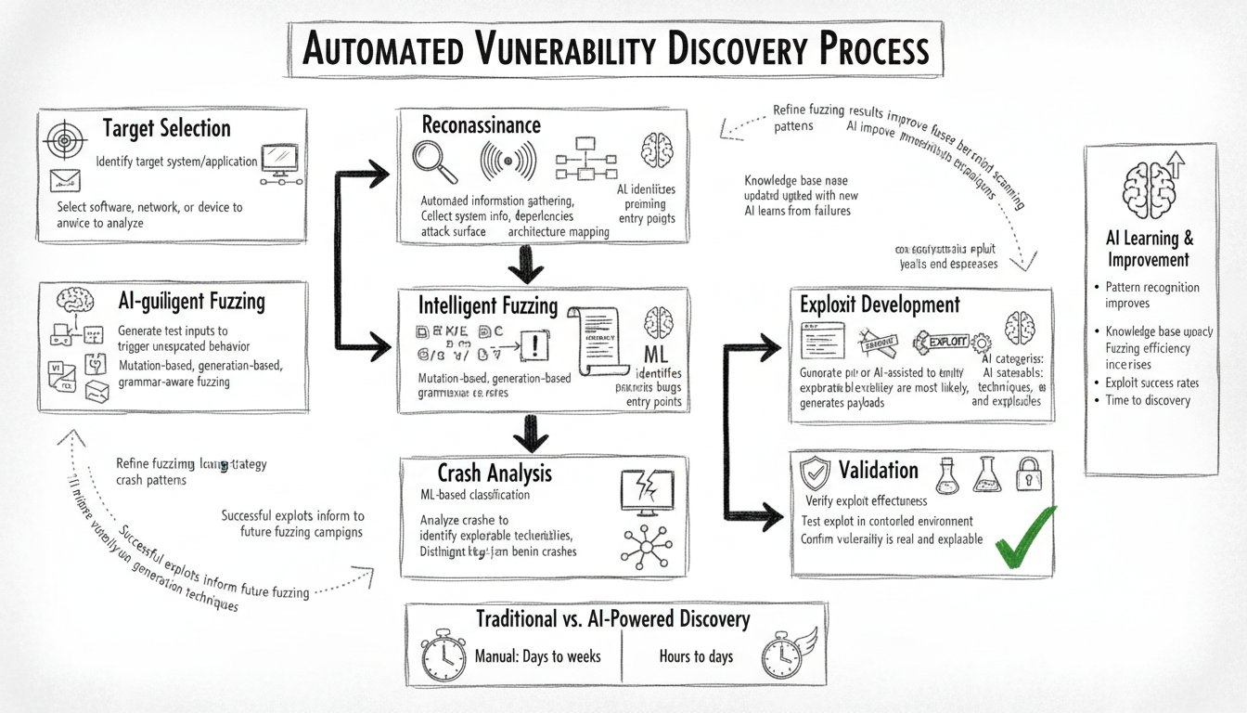
Real-World Discoveries with AI Fuzzing
01
02
03
OpenSSL Vulnerability
wolfSSL and SQLite Flaws
Impact on Security Testing
In November 2024, Google's AI-powered OSS-Fuzz tool discovered a critical vulnerability in OpenSSL that had been present for nearly 20 years. This flaw was missed by traditional testing despite strong code coverage, demonstrating AI's ability to uncover subtle issues.
AI fuzzing tools also identified vulnerabilities in wolfSSL, a cryptographic library, and SQLite, a widely used database engine. These discoveries highlight how AI can detect bugs that have evaded even thorough human examination for years.
AI-powered fuzzing enhances traditional methods by intelligently generating inputs targeted at specific code paths and continuously learning from results. This approach accelerates vulnerability detection and improves software security, uncovering hidden flaws quicker than manual methods.
Unmasking the Cyber Underworld: The Role of AI in Modern Crime and Defense Strategies

Slide 30
The Democratization of Hacking
01
02
03
04
Speed
Scale
Accessibility
Relentlessness
AI can scan and analyze large codebases in hours, significantly faster than human security audits that might take months. This acceleration means vulnerabilities are discovered with unprecedented rapidity, shrinking the window between exposure and potential exploitation.
AI systems can simultaneously analyze thousands of targets, overcoming the limitations of human researchers who focus on one project at a time. This vast scale increases the breadth of attack surfaces that can be probed and exploited automatically.
Sophisticated fuzzing and vulnerability discovery tools are now commercially available and accessible even on the dark web. This lowers barriers to entry, allowing criminals without deep expertise to launch advanced hacking campaigns using AI-powered methods.
Unlike humans, AI systems do not get tired or distracted. They perform exhaustive and systematic exploration of every accessible code path continuously, making the discovery process relentless and more thorough than manual methods.
Unmasking the Cyber Underworld: The Role of AI in Modern Crime and Defense Strategies

Slide 31
The Economics of AI-Powered Crime
Reduced Startup Costs
Increased Scalability
Faster Time to Launch
Lower Skill Requirement
Higher Success and Return
AI dramatically lowers the initial investment required for cybercrime. Traditional attacks cost tens of thousands of dollars, while AI tools and subscriptions range from just a few hundred to a few thousand dollars, making crime accessible to more actors.
AI technology allows cybercrime operations to scale almost without limit. Unlike traditional human-limited campaigns, AI enables attackers to target vast numbers of victims simultaneously with personalized attacks, increasing reach and impact.
Launching attacks has become significantly quicker with AI. While traditional campaigns might take days or weeks to prepare, AI-powered attacks can be launched within minutes to hours, accelerating the pace and frequency of cyber threats.
AI lowers the barrier to entry by automating technical and creative stages of attacks. What once relied on high programming and social engineering skills now requires only basic prompt writing and tool operation, enabling more attackers to participate.
AI-generated campaigns achieve higher success rates and generate larger returns per attack, sometimes an order of magnitude greater than traditional methods. This efficiency creates a favorable return on investment that drives continued growth of AI-powered crime.
Unmasking the Cyber Underworld: The Role of AI in Modern Crime and Defense Strategies

Slide 32
Crime-as-a-Service: The Underground Marketplace
Ransomware-as-a-Service
Phishing Kits
Deepfake Services
Credential Markets
Initial Access Brokers
Complete ransomware operations are available for purchase, including encryption tools, payment processing, and victim communication support. The service manages everything, requiring only target identification from the buyer.
Ready-made phishing campaigns provide convincing websites, email templates, and hosting infrastructure. AI-enhanced versions generate unique, personalized content for each target, making detection difficult.
Custom voice cloning and video synthesis services enable attackers to create controllable digital puppets from submitted samples, facilitating sophisticated impersonation attacks.
Marketplace for stolen usernames, passwords, and session tokens that offers ratings, reviews, and escrow services, treating stolen credentials as commodities.
Specialists who breach organizations and sell the obtained access to the highest bidder, using AI to accelerate reconnaissance and exploitation processes.
Unmasking the Cyber Underworld: The Role of AI in Modern Crime and Defense Strategies

Slide 33
Lowered Barriers to Entry
Widespread Access to AI Tools
Commercially available AI software and services have dramatically reduced the technical know-how required to launch cyberattacks. Tasks such as voice cloning, phishing content generation, and network reconnaissance no longer require programming skills or deep expertise.
Minimal Investment Needed
Advancements mean attackers can begin operations with minimal financial outlay. AI services range from free to low-cost subscriptions, making sophisticated attacks affordable, even for novices.
Automated Attack Generation
AI tools automate complex stages of attacks, including personalized content creation, vulnerability discovery, and coordination across multiple channels, reducing reliance on human labor and speeding up attack launch times.
Democratization of Cybercrime
The combination of accessibility, low cost, and automation enables individuals with limited experience to conduct advanced cyberattacks, resulting in a surge of AI-powered criminal activities across broader populations.
Unmasking the Cyber Underworld: The Role of AI in Modern Crime and Defense Strategies

Slide 34
The ROI of Voice Cloning
Investment vs. Return
The deepfake CEO fraud involved a relatively modest investment in AI voice synthesis software, likely costing a few hundred dollars, combined with target research and phone calls. In return, the criminals managed to fraudulently transfer $243,000 in a single afternoon, demonstrating an exceptional return on investment. This low cost contrasts sharply with traditional cybercrime methods requiring extensive technical expertise and infrastructure.
Scalability Potential
This method of attack is highly scalable. The same AI tools and tactics can be reused against countless targets with minimal extra investment. Even a 1% success rate across a wider campaign could generate significant returns, making voice cloning a cost-effective and powerful tool for criminals seeking extensive financial gain.
Unmasking the Cyber Underworld: The Role of AI in Modern Crime and Defense Strategies

Slide 35
The Ecosystem Effect and Organizational Structures
Successful Attacks Generate Capital
Refinement and Training of AI Systems
Each successful cyber attack generates financial capital that criminals reinvest into more advanced AI tools and services. This capital fuels further innovations and capabilities, enabling increasingly sophisticated and effective criminal operations. The flow of resources ensures a continuous cycle of improvement and scaling of attack methods.
The capital from successful attacks also provides data and opportunities to refine AI models. Criminals use outcomes and new data to improve their tools, creating more effective AI-powered techniques that can evade detection and increase success rates in future attacks.
Diversification into Structured Organizations
Expansion of Criminal Offerings and Market
Criminal enterprises evolve into structured organizations resembling legitimate businesses. They form startups innovating attack techniques, enterprises coordinating large operations, platforms enabling services, and investors funding new ventures. This diversification sustains the ecosystem and drives the continuous cycle forward.
With growing resources and advanced AI capabilities, criminal groups expand their service offerings into comprehensive platforms and marketplaces. These include crime-as-a-service, customized phishing campaigns, and AI-generated synthetic media, attracting more participants and enabling easier access to sophisticated cybercrime methods.
Unmasking the Cyber Underworld: The Role of AI in Modern Crime and Defense Strategies

